Slide 1
Presentation on Voice Controlled Intelligent Chatbot Course Name: Software Engineering Lab Course Code: CSE-402
Presented by
Kanis Fatema
Roll:17102010
Session: 2016-17 Presented to
Rubya Shaharin
Assistant Professor
Department of Computer Science and Engineering

Slide 2
Objectives
To describe about the project
How the project works
Which software engineering model is followed here
Limitations of the project
Future Scopes

Slide 3
What is chatbot?
A chatbot is a software application used to conduct an on-line chat conversation via text or text-to-speech
Two types of chatbots are available.
Speaker-dependent
Speaker-independent

Slide 4
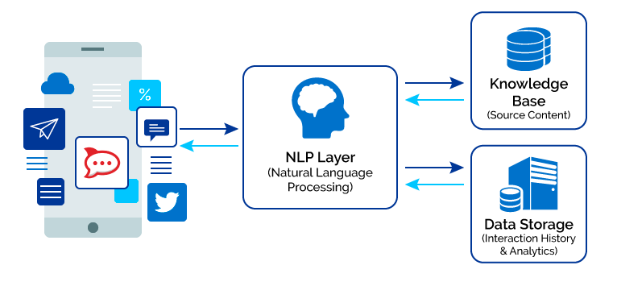

Slide 5
Working Procedure of our project
Greetings
Ready to take voice commands
Listen and Analyze the command
Recognize the command
Get information from internet
Give it to the user interface

Slide 6
Software Process
Specification – defining what the system should do;
Design and implementation – defining the organization of the system and implementing the system;
Validation – checking that it does what the customer wants;
Evolution – changing the system in response to changing customer needs.

Slide 7
Requirements
Software Requirements:
Python 3.8 platform
Pycharm 2021.2 IDE
Browsers : Firefox/chrome/opera mini

Slide 8
Software model that we have followed
Agile Model
Focus on the code rather than the design
Are based on an iterative approach to software development
Are intended to deliver working software quickly and evolve this quickly to meet changing requirements.
The aim of agile method is to :
Reduce overheads in the software process
Respond quickly to changing requirements without excessive rework.

Slide 9
Principles of Agile Project Management
Customer Satisfaction
Welcome Change
Delivery Frequently
Work Together
Motivated Team
Face to Face Interaction
Working Software
Constant Pace
Good Design
Simplicity
Self-organization
Reflect and Adjust

Slide 10
Agile Model(cont.)
Advantages:
continuous development and delivery of useful software.
Product is developed fast and frequently delivered
A face-to-face conversation is the best form of communication.
It continuously gave attention to technical excellence and good design.
Daily and close cooperation between business people and developers.
Regular adaptation to changing circumstances.

Slide 11
Agile Model(cont.)
Disadvantages:
Prioritizing changes can be difficult where there are multiple stakeholders.
Maintaining simplicity requires extra work.

Slide 12
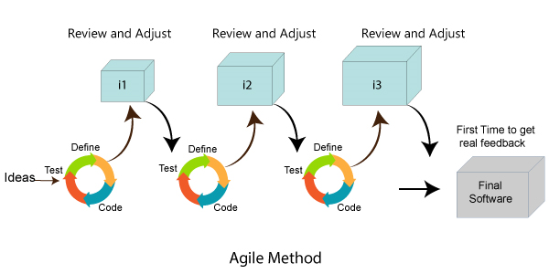
Agile Model(cont.)

Slide 13







Slide 14
How to manage the project
Project planning
Reporting
Risk management
People management
Proposal writing

Slide 15
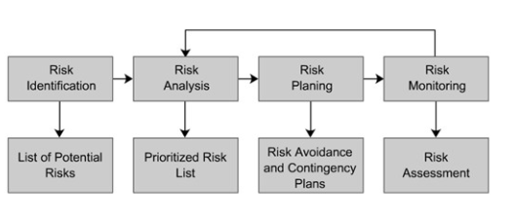
How to manage the project(cont.)

Slide 16
How to manage the project(cont.)
People Management:
Need satisfaction
Personality types
Selecting group members

Slide 17
Program Testing
show that a program does what it is intended to do
discover program defects before it is put into use.
part of verification and validation process
There are two testing goals:
Validation Testing
Defect Testing

Slide 18
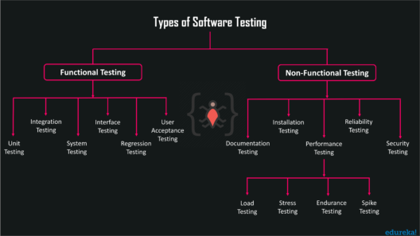
Program Testing(cont.)
Types of testing

Slide 19
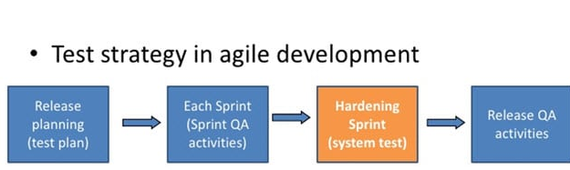
Test strategy in Agile Development

Slide 20
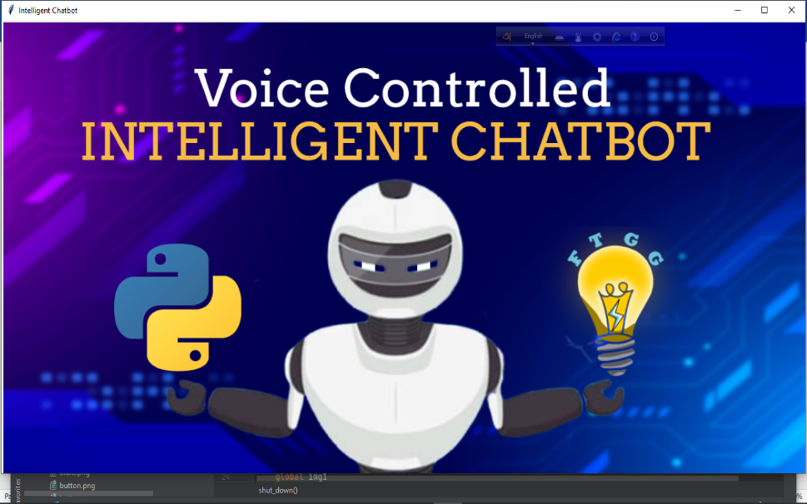
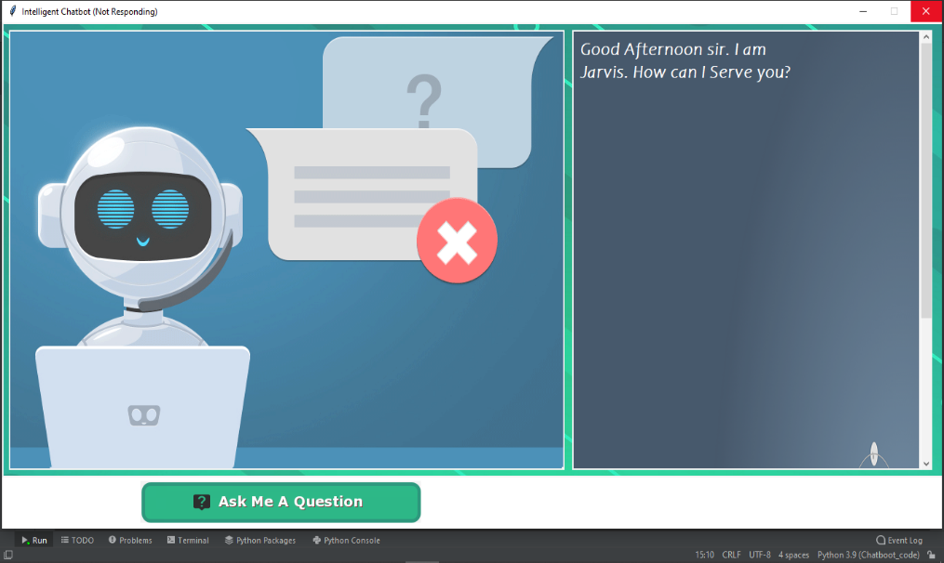
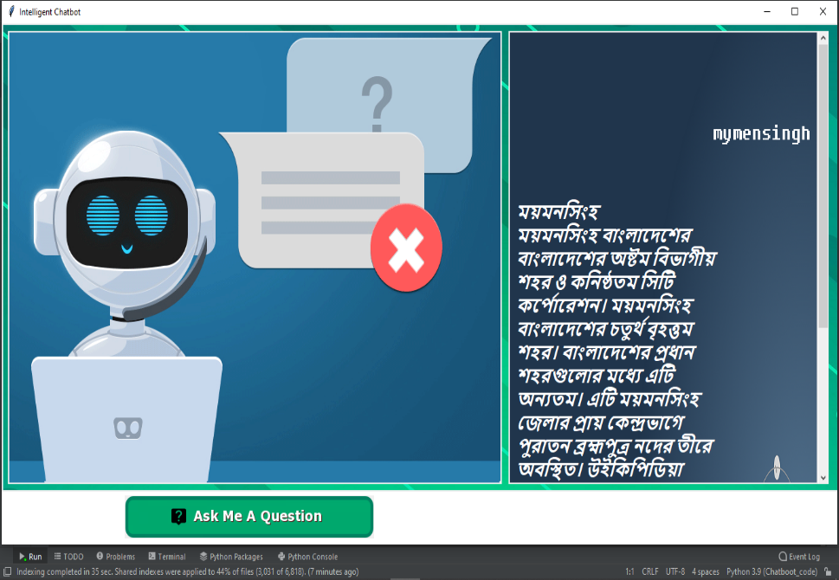
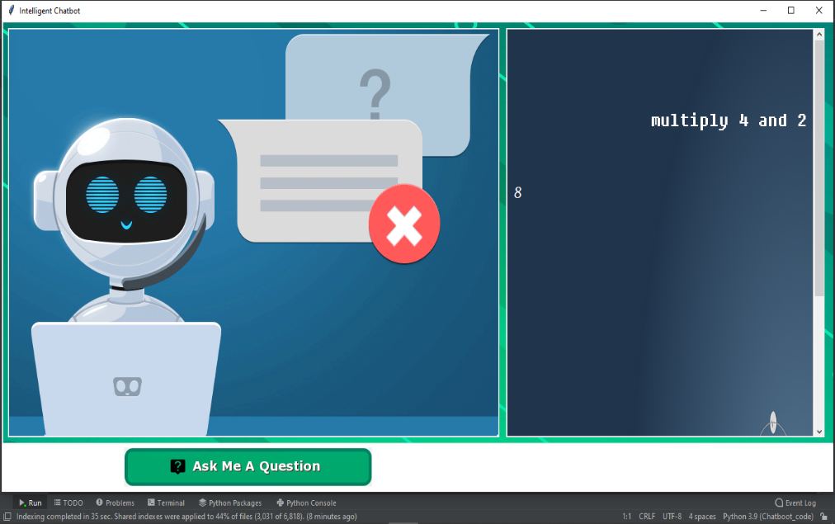
User Interfaces

Slide 21
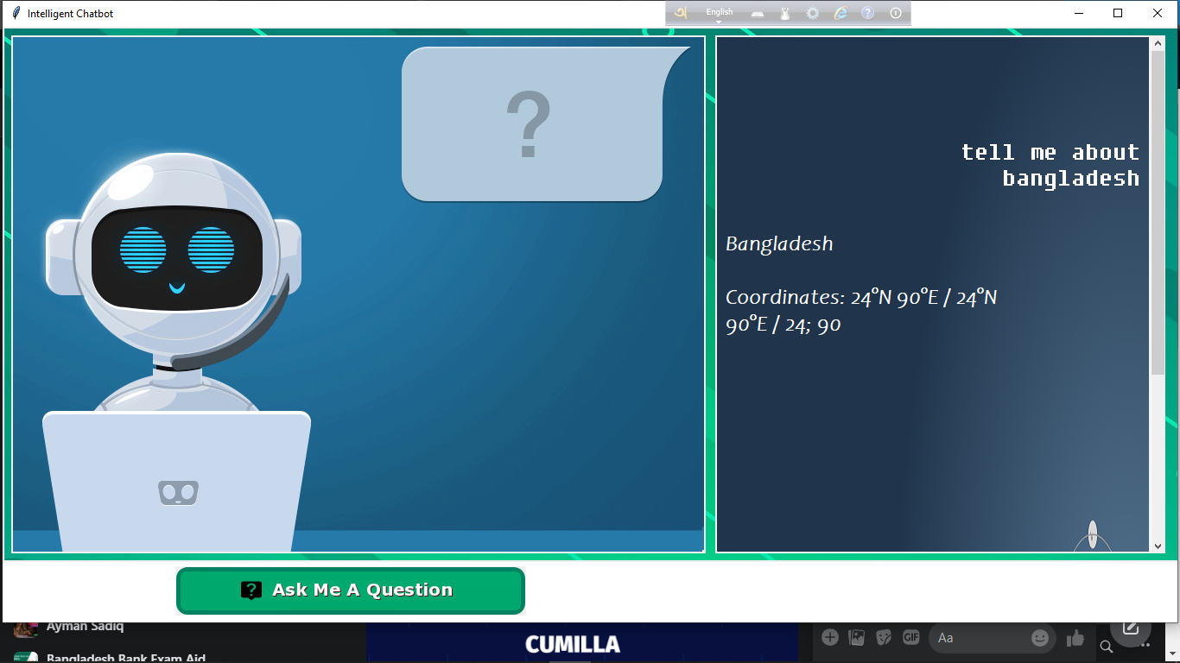
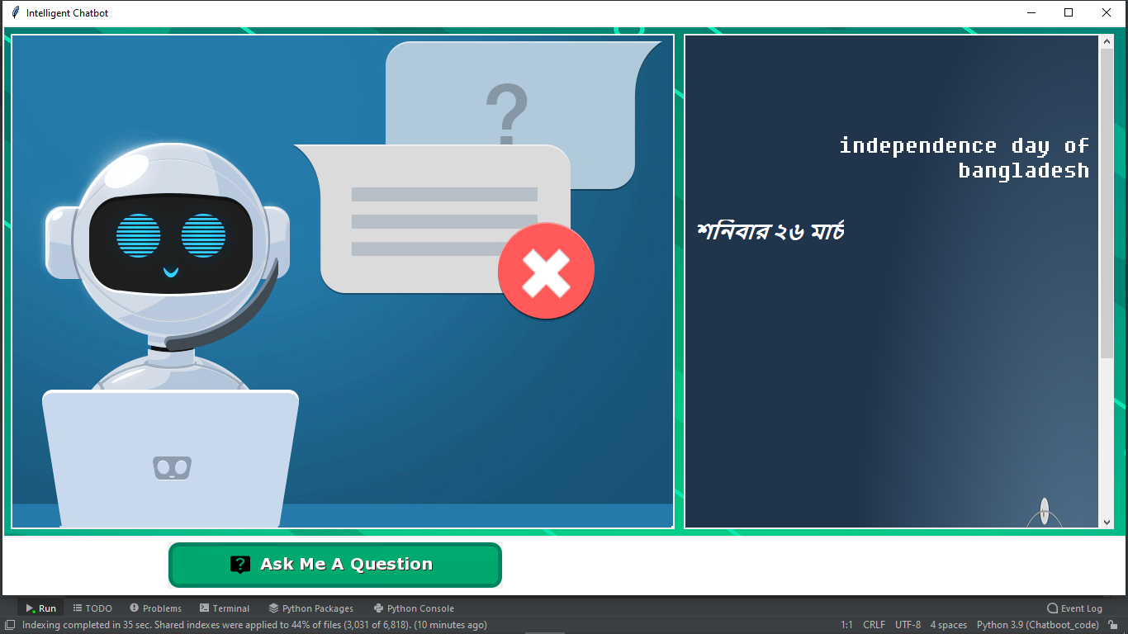
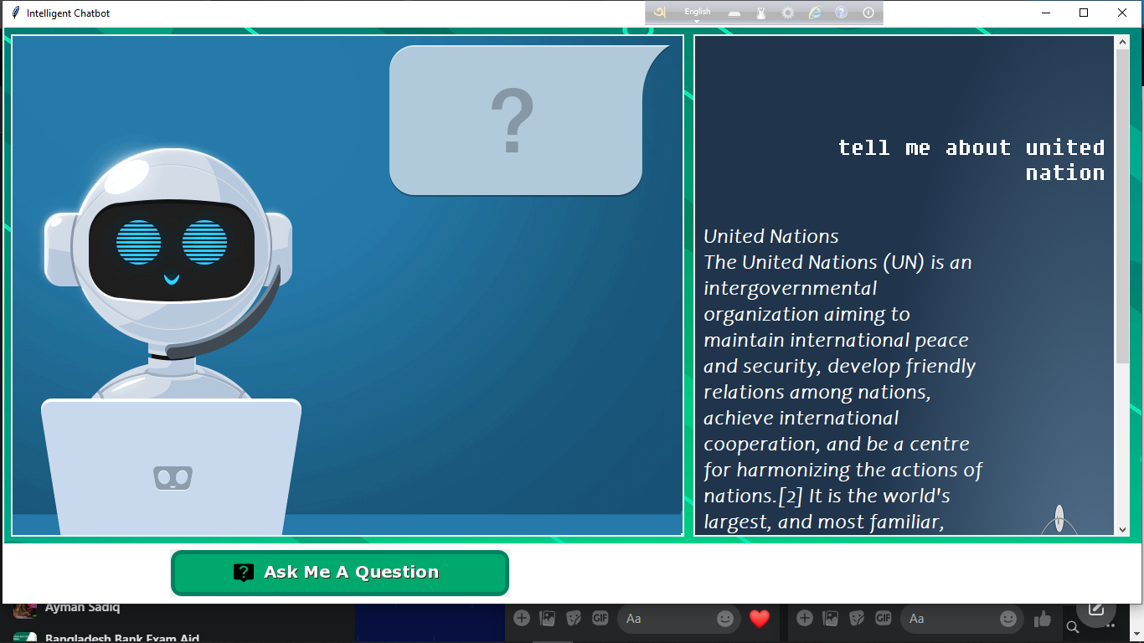
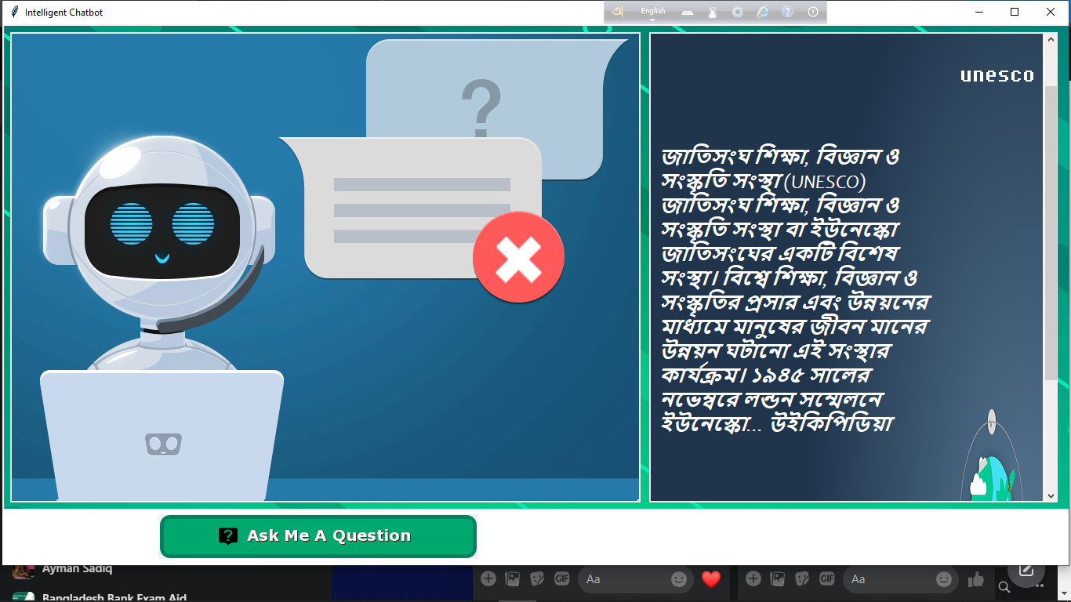
Interfeces

Slide 22
Limitations
Sometimes Jarvis is not taking the proper command
It will work only for online

Slide 23
Future Scopes
Mobile App Integration
Voice-Tech In Healthcare
Smart Displays
Operate entire operating system modules

Slide 24
Thank you

Slide 25
Any Question?

